Slide 1

Asset Marketability Scoring Model
Manivannan Karuppusamy
October 2018

Slide 2
Scope of the project
Mortgage servicer provides foreclosure properties to a Mortgage company to sell these properties through an .com company or other external channels, both online and via realtors
70% of the assets (properties) are sold within 90 days with the remaining 30% of the assets take over 120 days, sometimes significantly longer. Note that these 30% are a key concern
Property valuation is done through the BPO process and/or by a 3rd party independent vendor for this 30% of the properties to evaluate the current market price. This involves cost and redo of the entire valuation again.
Mortgage servicer provides foreclosure properties to a Mortgage company to sell these properties through an .com company or other external channels, both online and via realtors
70% of the assets (properties) are sold within 90 days with the remaining 30% of the assets take over 120 days, sometimes significantly longer. Note that these 30% are a key concern
Property valuation is done through the BPO process and/or by a 3rd party independent vendor for this 30% of the properties to evaluate the current market price. This involves cost and redo of the entire valuation again.
Provide an overall increased understanding of the asset data and provide insights as input to the asset marketability scoring with next step recommendations

Slide 3
Process flow
Auction process
Successful bid
Bid > Reserve
Low bid
Entire recycle happens again it is more cost driven. Need to get more insight about low and no bid properties
Yes
No
Manual review
Property sold
Recycle
Yes
No

Slide 4
Modeling Approach/Methodology
Objective: Estimate the probability of sale of the Asset by assigning scores to each
attribute as impact – the combined output becomes the Asset Score
Approach/Methodology:
Initially assume that only property characteristic will be determinants of the
probability of sale, such as # of bedrooms, Age, # of bathrooms, Built Area
(Sq. footage), lot area etc. - expand as validation/iterations occur
Assign points to Property characteristics in order to derive a numerical value that
reflects the probability of a sale
The score is estimated using a regression model, with the regression coefficients mathematically transformed into Points
The pre-modeling stage provides the data preparation, derive new characteristics
such as ratios, interaction terms, attributes and critical characteristic using Weight of evidence (WOE) and Information value (IV)

Slide 5
Modeling Approach/Methodology - continued
The modeling stage determines the statistically significant characteristics, validates the accuracy of fits, tests the hypothesis and transforms the coefficients to the score for decisions
The post-modeling stage validates the model both in-sample (80:20), out-sample and model stability using the various metrics
Since Target variable is Binomial (Sold=1 , Unsold=0), we will using Logistic regression
All Independent categorical variable will be replaced with WOE values and then modeled.
Different iteration models will be done and based of several Metrics - AIC, Concordance and Disconcordance, Divergence and KS stats we will choose the best model.
For non-statistician’s Plot of Marginal distribution of Sold and Unsold over probabilities or Scores and Lift charts are graphical representations of showing how good the model.
Scaling/Scoring:
Ln(odds) will be computed for each property, Ln(odds) will convert them into Scores , using Math equations.

Slide 6
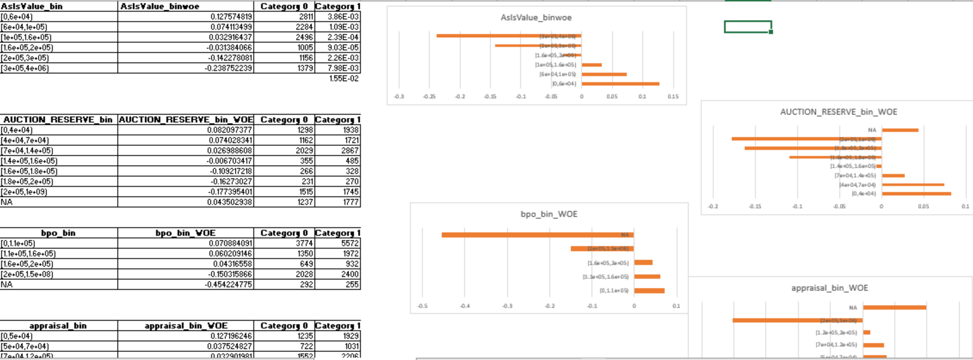
WOE for Independent variables

Slide 7
Modeling variables
Coefficients:
 | Estimate | Std. Error | Z value | Pr(>|z|)
(Intercept) | 0.32524 | 0.01869 | 17.401 | 2.00E-16 | ***
Occ_St_MEwoe | 1.26603 | 0.12899 | 9.815 | 2.00E-16 | ***
price_drift_binwoe | 0.77849 | 0.10047 | 7.748 | 9.31E-15 | ***
CURRENT_UPB_binwoe | 0.9107 | 0.18656 | 4.882 | 1.05E-06 | ***
Agent_Prop_Conditionwoe | 1.2855 | 0.18478 | 6.957 | 3.48E-12 | ***
Price_sqft_binwoe | 0.89356 | 0.17856 | 5.004 | 5.61E-07 | ***
Drv_Valuation_Typewoe | 0.92471 | 0.02849 | 32.453 | 2.00E-16 | ***
bath_binwoe | 1.00881 | 0.12188 | 8.277 | 2.00E-16 | ***
State1woe | 0.97382 | 0.0565 | 17.236 | 2.00E-16 | ***
Avg_Sold_Days_of_BPO_Sold_Comps_binwoe | -0.27138 | 0.11884 | -2.284 | 0.0224 | *
season_invwoe | 0.76902 | 0.04446 | 17.298 | 2.00E-16 | ***
Census_Urban_Ruralwoe | 0.81244 | 0.12174 | 6.673 | 2.50E-11 | ***
Conditionwoe | 0.71021 | 0.05887 | 12.064 | 2.00E-16 | ***
age_yr_binwoe | 0.65777 | 0.10485 | 6.274 | 3.53E-10 | ***
RP_Comp_Score_Avg_binwoe | 0.45853 | 0.10071 | 4.553 | 5.29E-06 | ***

Slide 8
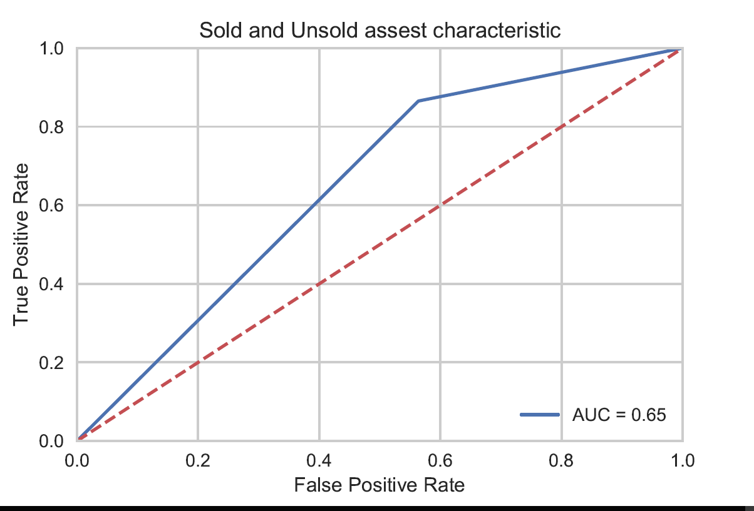
Lift Chart

Slide 9
Model/Business Benefits
Based on the model probabilities/ score will determine the properties that can be sold in the market within 90 days of listing
Rank ordering the properties based on the score and targeting the hot properties based on the list
Reducing the manual review, saving $$ in the entire recycle process
Quick sale of properties, reduces valuation cost, pressure of holding the properties for longer duration.
Overcoming the repetitive process

Slide 10
Thank you @ Greg, Carleton, Travis and William

